Slide 1


How to spot helpful reviews?
Michael Nguyen

Slide 2

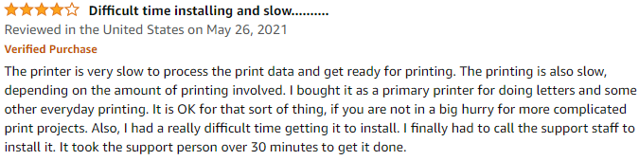

Why Review?
Business Case
More than 90% of customers read reviews before making a purchase based on data from FanandFuel
People tend to buy a product with reviews 270% more than those without based on a research from Northwestern University
Help both customers and businesses in long term by establishing trust
Good Review vs Bad Review
HP DeskJet 4155e All-in-One Wireless Color Printer

Slide 3
Why Review?
Build a machine learning model to spot helpful review using data from Amazon.

Slide 4

Data Overview
Data from Amazon with over 2 million reviews for office product
Notable features:
customer_id: the unique id of the customer
review_id: the unique id of the review
product_id: the unique id of the product
review_body: the body text of the review
star_rating: the rating of the review that ranges from 1 to 5
total_votes: the total votes on the review
helpful_votes: the number of helpful votes on the review
verified_purchase: a marker that verify whether a reviewer actually purchase the product

Slide 5
Data Wrangling
Remove columns/rows with excessive amount of missing data
Drop redundant column
Only consider purchases that are verified
Create new column for review length
We go from 2.6 mil reviews to 2.2 mil reviews

Slide 6
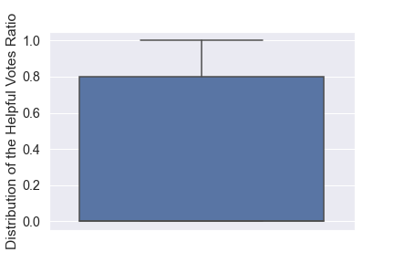
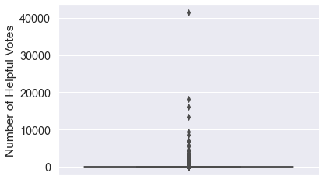
Metric Identification
Possible Metric: helpful_votes

Slide 7
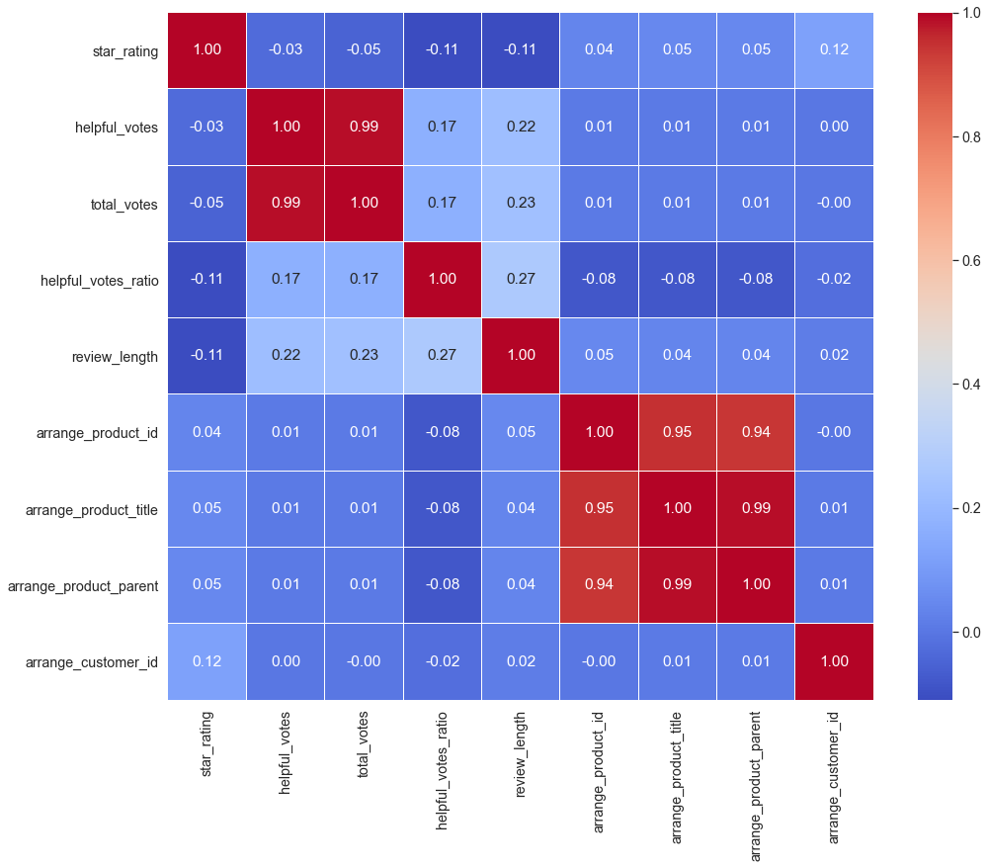
Features Correlation
The "helpful_votes_ratio" does correlate strongest with the "review_length.”
There's little correlation for the "helpful_votes_ratio" to features such as the products and the identity of the customers giving it

Slide 8
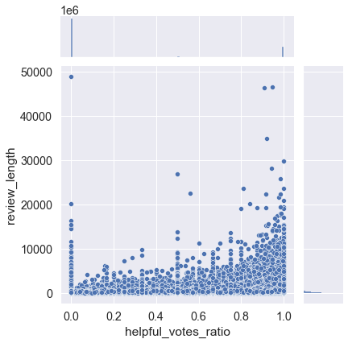
helpful_votes_ratio vs. review_length
that longer reviews tend to be more helpful than shorter ones
makes sense since short reviews such as: "It's a good product" or "I like it" do not contain much information

Slide 9
Cleaning Reviews
Tokenization
the procedure of extracting words from a sentence.
For ex: “This is my dog.” can be tokenized into:
Unigram: “this”, “is”, “my”, “dog”
Bigram: “this is”, “is my”, “my dog”
Remove stopwords
Stopwords are words that appear too common in most sentences. For example: “the,” “is,” “are”. Their frequent appearance will hinder our ability to extract essential features from the sentences.
Lemmatization
the process of returning the base or dictionary form of a word known as lemma. For example, the term “kept” and “keeps” can be lemmatized into “keep.”

Slide 10
TF-IDF
Vectorize the texts to feed to our models
One popular method is Term Frequency – Inverted Document Frequency (TF-IDF)
All reviews will be represented by a giant matrix
Each row corresponds to a review
Each column corresponds to a token
Values are calculated according to:
TF-IDF = TF log₁₀(N/DF)
TF of a token is the frequency it appears in a review
N is the number of reviews
DF is the number of reviews with the token under consideration
Too common or rare tokens across all the reviews will not contribute too much to our models

Slide 11
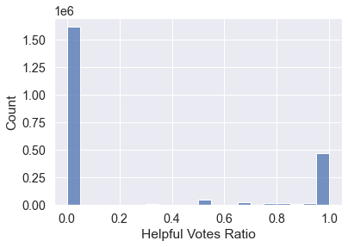
Data Preprocessing

Slide 12
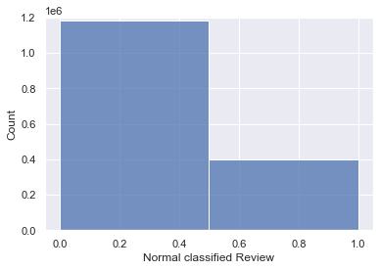
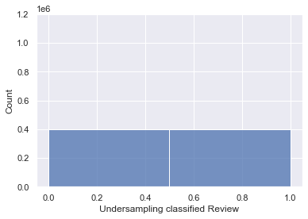
Resampling Trial Set
Accuracy
F1 Score

Slide 13
Model Selection
Model:
Dummy Classifier
Logistic Regression
Random Forest
Gradient Boots
Naïve Bayes
Linear Discriminant Analysis
Tokens: Unigram vs. Bigram
Resampling or Not

Slide 14
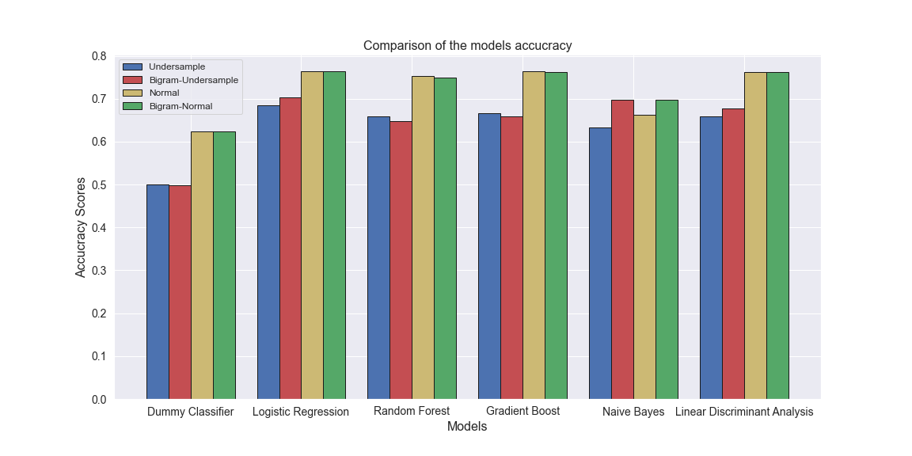
Model Comparisons According to Accuracy

Slide 15
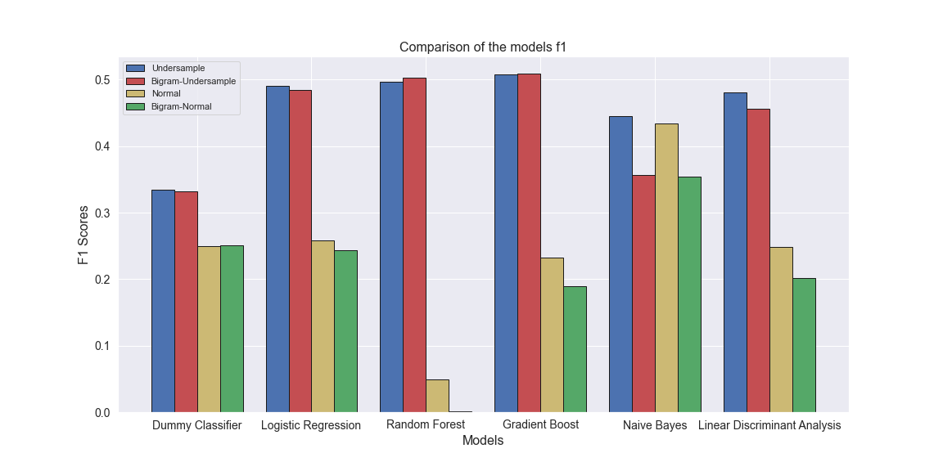
Model Comparisons According to F1 Score

Slide 16
Conclusion and Future Direction
Relatively simple model with 0.75 accuracy or 0.5 f1 score
Choosing a model based on its accuracy or f1 score is not straightforward
Coordinate with marketing to understand impact of reviews
More features in our model such as prices of product, how popular it is etc.
More complicated model such as recurrent neural network

